Slide 1

Marketing Analytics
Presented by
Gina Lilipaly
Email
Github
LinkedIn
lilipalygina05@gmai.com
github.com/ginnadalilipaly
LinkedIn.com/in/gina

Slide 2
Table of Contents
Project Background
Dashboard Overview
Data Processing Journey
Recommendations
Marketing Analytics
Gina Lilipaly

Slide 3



Project Background
Goals:
An online retail business, faced declining customer engagement and conversion rates despite launching several new online marketing campaigns. Marketing analysis is carried out to help analyze in detail and identify areas that need to be improved in marketing strategies.
Increase Conversion Rates
Goal: Identify factors impacting the conversion rate and provide recommendations to improve it.
Insight: Highlight key stages where visitors drop off and suggest improvements to optimize the conversion funnel.
Key Perfomance Indicators (KPIs):
Conversion Rate
Average Order Value (AOV)
Enhance Customer Engagement
Percentage of website visitors who make a purchase
Average amount spent by a customer per transaction
Goal: Determine which types of content drive the highest engagement.
Insight: Analyze interaction levels with different types of marketing content to inform better content strategies
Customer Engagement Rate
Customer Feedback Score
Improve Customer Feedback Scores
Level of interaction with marketing content (clicks, likes, comments)
Average rating from customer reviews
Goal: Understand common themes in customer reviews and provide actionable insights.
Insight: Identify recurring positive and negative feedback to guide product and service improvements.
Tools Used:
Marketing Analytics
Gina Lilipaly

Slide 4

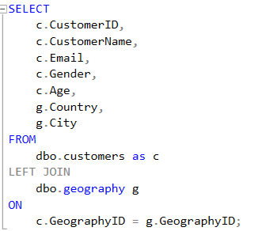
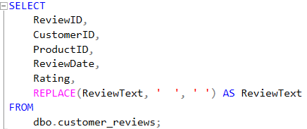
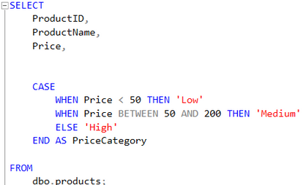
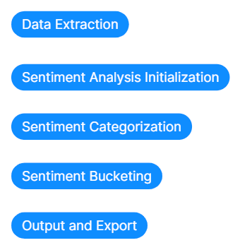
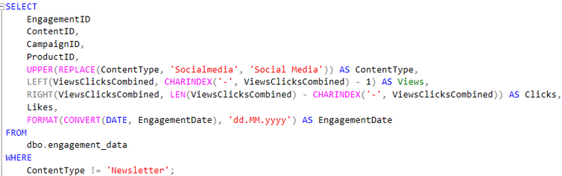
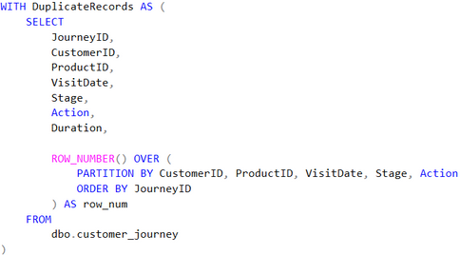
Data Processing
SQL
SQL statement to enrich customer data with geographic information
Query to clean whitespace issues in the ReviewText column
SQL Query to categorize products based on their price
Python
Data Extraction
Sentiment Analysis Initialization
Query to clean and normalize the engagement_data table
(CTE) to identify and tag duplicate records
Sentiment Categorization
Sentiment Bucketing
Output and Export
Marketing Analytics
Gina Lilipaly

Slide 5
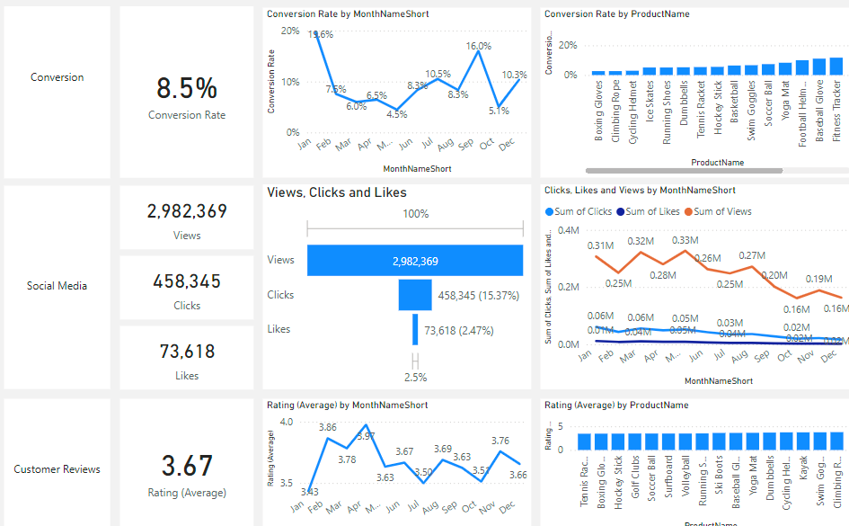
Dashboard
Overview
Decreased Conversion Rates
The conversion rate demonstrated a strong rebound in December, reaching 10.3%, despite a notable dip to 5.1% in October.
Reduced Customer Engagement
There is a decline in overall social media engagement, with views dropping throughout the year
While clicks and likes are low compared to views, the click-through rate stands at 15.37%, meaning that engaged users are still interacting effectively
Reduced Customer Engagement
Customer ratings have remained consistent, averaging around 3.67 throughout the year
•Although stable, the average rating is below the target of 4.0, suggesting a need for focused improvements in customer satisfaction, for products below 3,5.
Marketing Analytics
Gina Lilipaly

Slide 6
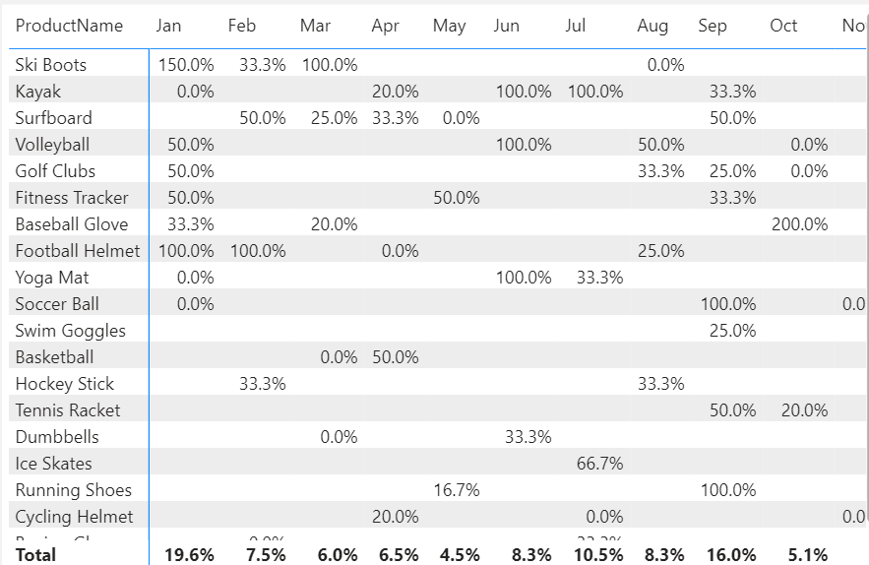
Dashboard
Decreased Conversion Rate
General Conversion Trend
Throughout the year, conversion rates varied, with higher numbers of products converting successfully in months like February and July. This suggests that while some products had strong seasonal peaks, there is potential to improve conversions in lower-performing months through targeted interventions.
Reduced Customer Engagement
May experienced the lowest overall conversion rate at 4.5%, with no products standing out significantly in terms of conversion. This indicates a potential need to revisit marketing strategies or promotions during this period to boost performance.
Reduced Customer Engagement
January recorded the highest overall conversion rate at 19.6%, driven significantly by the Ski Boots with a remarkable 150% conversion. This indicates a strong start to the year, likely fueled by seasonal demand and effective marketing strategies.
Marketing Analytics
Gina Lilipaly

Slide 7
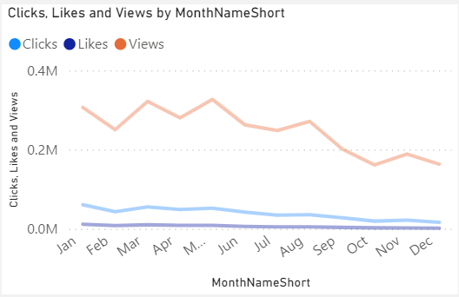
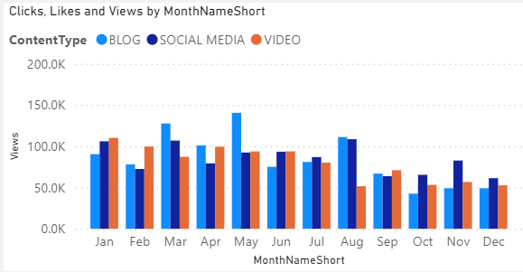
Dashboard
Reduced Customer Engagement
Declining Views
Views peaked in February and July but declined from August and on, indicating reduced audience engagement in the later half of the year.
Low Interaction Rates
Clicks and likes remained consistently low compared to views, suggesting the need for more engaging content or stronger calls to action.
Content Type Perfomance
Blog content drove the most views, especially in March and May, while social media and video content maintained steady but slightly lower engagement.
Marketing Analytics
Gina Lilipaly

Slide 8
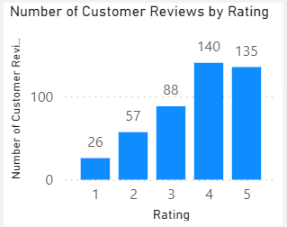
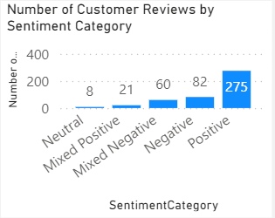
Dashboard
Reduced Customer Engagement
Customer Ratings Distribution
The majority of customer reviews are in the higher ratings, with 140 reviews at 4 stars and 135 reviews at 5 stars, indicating overall positive feedback. Lower ratings (1-2 stars) account for a smaller proportion, with 26 reviews at 1 star and 57 reviews at 2 stars.
Sentiment Analysis
Positive sentiment dominates with 275 reviews, reflecting a generally satisfied customer base. Negative sentiment is present in 82 reviews, with a smaller number of mixed and neutral sentiments, suggesting some areas for improvement but overall strong customer approval
Opportunity for Improvement
The presence of mixed positive and mixed negative sentiments suggests that there are opportunities to convert those mixed experiences into more clearly positive ones, potentially boosting overall ratings. Addressing the specific concerns in mixed reviews could elevate customer satisfaction.
Marketing Analytics
Gina Lilipaly

Slide 9
Recommendation
Target High-Performing Product Categories:
Increase Conversion Rates
Focus marketing efforts on products with demonstrated high conversion rates, such as Kayaks, Ski Boots, and Baseball Gloves. Implement seasonal promotions or personalized campaigns during peak months (e.g., January and September) to capitalize on these trends.
Revitalize Content Strategy:
Enhance Customer Engagement
To turn around declining views and low interaction rates, experiment with more engaging content formats, such as interactive videos or user-generated content. Additionally, boost engagement by optimizing call-to-action placement in social media and blog content, particularly during historically lower-engagement months (September-December).
Address Mixed and Negative Feedback
Improve Customer Feedback Scores
Implement a feedback loop where mixed and negative reviews are analyzed to identify common issues. Develop improvement plans to address these concerns. Consider following up with dissatisfied customers to resolve issues and encourage re-rating, aiming to move average ratings closer to the 4.0 target.
Marketing Analytics
Gina Lilipaly

Slide 10
Thank You!
Email
Github
LinkedIn
lilipalygina05@gmai.com
github.com/ginnadalilipaly
LinkedIn.com/in/gina

